Slide 1
Climate Crisis Ai Hackathon | Jan 22-24
#challenge-sea-ice
Estimate the velocity of drifting sea ice to help us better understand the dynamical response of the Arctic Ocean to a changing climate.
A kaggle-style challenge proposed by Charles Brunette & Bruno Tremblay, McGill University
by Team Earth Rescuers

Slide 2
OUTLINE
INTRODUCTION
OBJECTIVES OF THIS CHALLENGE
DELIVERABLES OF THIS CHALLENGE
METHODOLOGY
REFERENCE
‹#›
Notes:
Prof. Dr. Max Mustermann | Name of Faculty
‹#›
Prof. Dr. Max Mustermann | Name of Faculty

Slide 3
INTRO: Climate Change & Arctic Sea Ice Drift
Arctic sea ice drifts under the influence of winds and ocean currents.
Ice motion is important - up to several kilometers per day. ​
Tracking the movement of sea ice can be applied to different research questions:
Transition from older sea ice to younger seasonal ice packs
Transport of ice-rafted sediments, or pollutants in the context of an oil spill,
Risk assessment associated with navigation and marine operations in the Arctic.
As sea ice experiences convergent motion, it ridges and forms thick piles of sea ice, or to the contrary, divergent ice motion leads to the formation of open water areas or leads.
‹#›
Notes:
Prof. Dr. Max Mustermann | Name of Faculty
‹#›
Prof. Dr. Max Mustermann | Name of Faculty

Slide 4
INTRO: Climate Change & Arctic Sea Ice Drift
These changes in the ice thickness distribution of the pack ice consequently influence the melt of sea ice in the summer.
Information about the velocity of sea ice is required for performing sea ice tracking; and in a perfect world, we would like this information to be available everywhere in the Arctic in space and time.
The most reliable information about ice motion comes from passively drifting buoys that were deployed in the Arctic over the last few decades.
This arouse our interest so we decided to dig further and find out more hence our reason for choosing this challenge.
‹#›
Notes:
Prof. Dr. Max Mustermann | Name of Faculty
‹#›
Prof. Dr. Max Mustermann | Name of Faculty

Slide 5
Why is this challenge important in 2021?
Shortages in freshwater
Increasing global temperatures due to loss of sea ice leading to decreased reflection of solar energy
Decreased diversity and acceleration of species extinction of surrounding marine life

Slide 6
Challenge Objectives
Build a machine learning model that best predicts buoy drift velocity, based on:
Wind velocity
And other relevant features like:
Sea-ice concentration
Sea-ice thickness
Distance to coast
‹#›
Notes:
Prof. Dr. Max Mustermann | Name of Faculty
‹#›
Prof. Dr. Max Mustermann | Name of Faculty

Slide 7
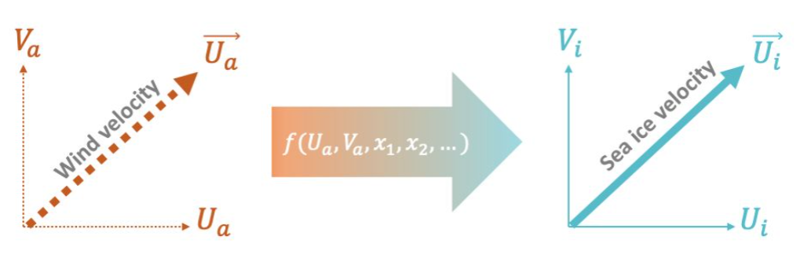
Arctic Sea Ice Motion Dataset
40 years of data
Velocity of Arctic buoys (U​a and Va​) used to estimate sea ice velocity
Velocity of co-located winds (Ui, Vi)
Sea ice conditions
Sea ice concentration
Sea ice thickness
Distance to coast
‹#›
Notes:
Prof. Dr. Max Mustermann | Name of Faculty
‹#›
Prof. Dr. Max Mustermann | Name of Faculty

Slide 8
OUR DELIVERABLES
Use the DRIFT_DATA_TRAINING.csv data, build a model that estimates daily u-components and v-components of sea ice velocity (U​i and V​i​), based on wind velocity (U​a and V​a) and the other parameters that are provided.
Return a list of ice motion estimates (U​​i and V​i) from the test data provided in DRIFT_DATA_TEST.csv; this output will be compared to buoy drift observations to evaluate the performance of your model. The evaluation will be based on the root-mean-square error for:
Error on sea ice speed:
Directional error
‹#›
Notes:
Prof. Dr. Max Mustermann | Name of Faculty
‹#›
Prof. Dr. Max Mustermann | Name of Faculty

Slide 9
Methodology
Read the guidelines & reformulate the problem
Visualize the data
Normalize the data
Train a simple linear regression model
Get first results
Feature reduction with PCA
Try different models
Read state of the art
KNN
Ridge
Random Forest
MLP
Tune the models
Use the best model to predict on test set
‹#›
Notes:
Prof. Dr. Max Mustermann | Name of Faculty
‹#›
Prof. Dr. Max Mustermann | Name of Faculty
Collaboration Platforms: Slack, ZOOM, Google Collaboratory (Python)
Python libraries: seaborn, matplotlib, sklearn, pandas etc.
We selected x_Ease, y_Ease for variable x and u_bouy and v_bouy for the variable y
We replaced missing data with zero
We used multi linear regression model (y=mx+c) since the drift velocity equation is linear as shown below
We used Seaborn for the data visualization

Slide 10

Choices
Collaboration Platforms: Slack, ZOOM, Google Collaboratory (Python)
Python libraries: seaborn, matplotlib, sklearn, pandas etc.
Models intuitions:
multi linear regression and linear regression model
since the drift velocity equation is linear as shown below
Missing data:
We replaced missing data with zero

Slide 11
Results
Results obtained using:
Cross-validation (5CV)
80/20 split
Method | Mean Squared Error
Logistic Regression | 25.5
KNN | 18.8
Ridge | 26.8
Random Forest | 15.9
MLP | 19.5
‹#›
Notes:
Prof. Dr. Max Mustermann | Name of Faculty
‹#›
Prof. Dr. Max Mustermann | Name of Faculty

Slide 12
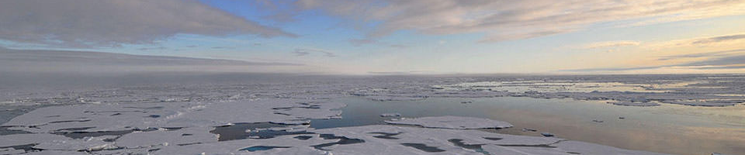
How does this insight help you?
Adaptation Strategies
‹#›
Notes:
Prof. Dr. Max Mustermann | Name of Faculty
‹#›
Prof. Dr. Max Mustermann | Name of Faculty

Slide 13
What did we learn?
Workflows in data preparation, data exploration, and relevant machine learning techniques
Through data, it is possible to understand environmental issues and what we could do about it.
How crucial teamwork is in intensive collaborative projects.

Slide 14
Future Directions
Find another way to deal with missing value
Perform a longer training
Find new features
‹#›
Notes:
Prof. Dr. Max Mustermann | Name of Faculty
‹#›
Prof. Dr. Max Mustermann | Name of Faculty
Since our r score value is 0.5 which proves the partial accuracy of our model, we will recommend an alternative model for this project.

Slide 15
REFERENCE
1. Challenge Guidelines
https://tc.copernicus.org/preprints/tc-2019-159/tc-2019-159.pdf
‹#›
Notes:
Prof. Dr. Max Mustermann | Name of Faculty
‹#›
Prof. Dr. Max Mustermann | Name of Faculty

Slide 16
MERCI !!!!!
‹#›
Notes:
Prof. Dr. Max Mustermann | Name of Faculty
‹#›
Prof. Dr. Max Mustermann | Name of Faculty

